Slide 1
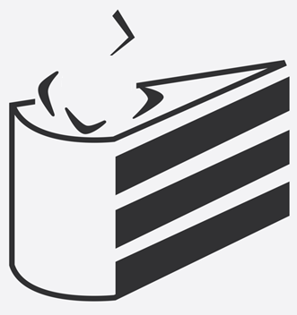

Welcome
from python import LIE
Python Language Immersion & Education Group

Slide 2
Master’s of the Trade

Slide 3



Slide 4
Mark Kiel, MD. PhD., CSO & Co-founder
Startup based on Python, Ruby, PERL, and JavaScript
(developer) Don’t worry about the big picture…?
Don’t think “that’s how it has always been done”
Be Agile
There are more jobs for code-capable data scientists than there are code-capable data scientists*
Essentially, you can name your own price

Slide 5
Code Review
def iter_slices(string, slice_length):
pos = 0
if slice_length is None or slice_length <= 0:
slice_length = len(string)
while pos < len(string):
yield string[pos:pos + slice_length]
pos += slice_length

Slide 6
Types of Code

Slide 7
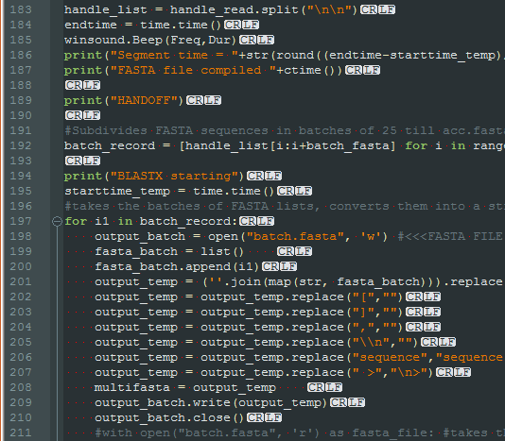
Spaghetti code
Program flow is conceptually like a bowl of spaghetti, i.e. twisted and tangled

Slide 8
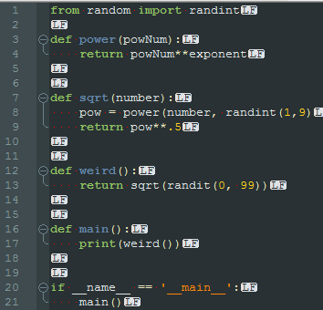
Ravioli code
overzealous separation and encapsulation of code can bloat call stacks and make navigation through the code for maintenance purposes more difficult

Slide 9
Lasagna code
Too complex to have an example. Just means having a rich environment that has multiple layers that stack on top of each other to create a big picture. However, doing so to the extreme can make your code base very complex and impenetrable

Slide 10
import this
Beautiful is better than ugly.
Explicit is better than implicit.
Simple is better than complex.
Complex is better than complicated.
Flat is better than nested.
Readability counts.
Although practicality beats purity.
If the implementation is hard to explain, it's a bad idea.
If the implementation is easy to explain, it may be a good idea.

Slide 11
Basic formatting
The two accepted fonts for display of Python are Courier New and Lucida Console
A proper tab or indent is 4 spaces…not a ‘\t’
End of Line (EOL) character(s) are:
Linux & macOS: \n
Windows: \r\n
Maximum line length is 79 characters.

Slide 12
When using an inline comment, a space must come before your comment and after the # sign
(e.g. # inline comment here)
Two blank lines should come before and after every function declaration
If running from the command line, one should always put the shebang #!/usr/bin/env python at the top of the script
many, many, many more ….

Slide 13
Function Anatomy
Definition/declaration of the function
def iter_slices(string, slice_length):
pos = 0
if slice_length is None or slice_length <= 0:
slice_length = len(string)
while pos < len(string):
yield string[pos:pos + slice_length]
pos += slice_length
Function Arguments
Return/yield* statement

Slide 14
Let’s go through the motions
Essentially, functions are just re-usable chunks of code
However, good functions follow specific style guidelines…

Slide 15
Live Code

Slide 16
Planning
Good code ought to start with pseudocode:
Exercise: write pseudocode for a function that takes a number and an exponent as arguments
It should return the square root of the sum of the number raised to the power of the exponent and the exponent raised to the power of the number

Slide 17
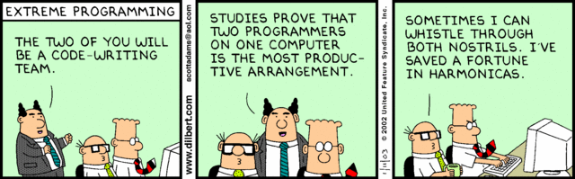
Pair Programming
Pair up. You’ve got work to do!

Slide 18
Workshop
Using ONLY the standard library (no Numpy), develop a function that takes two lists of lists called ‘cipher’ and ‘text’.
The cipher and text will always be square and the same dimensions.
Using the cipher, find the index of all the ‘X’.
Use those indices on the text to find a code.
Now, rotate the cipher 90˚ clockwise (not the text).
Find the code.
Repeat until 3 rotations have occurred.
Concatenate all 4 results into one string

Slide 19


Before rotation
After rotation

Slide 20
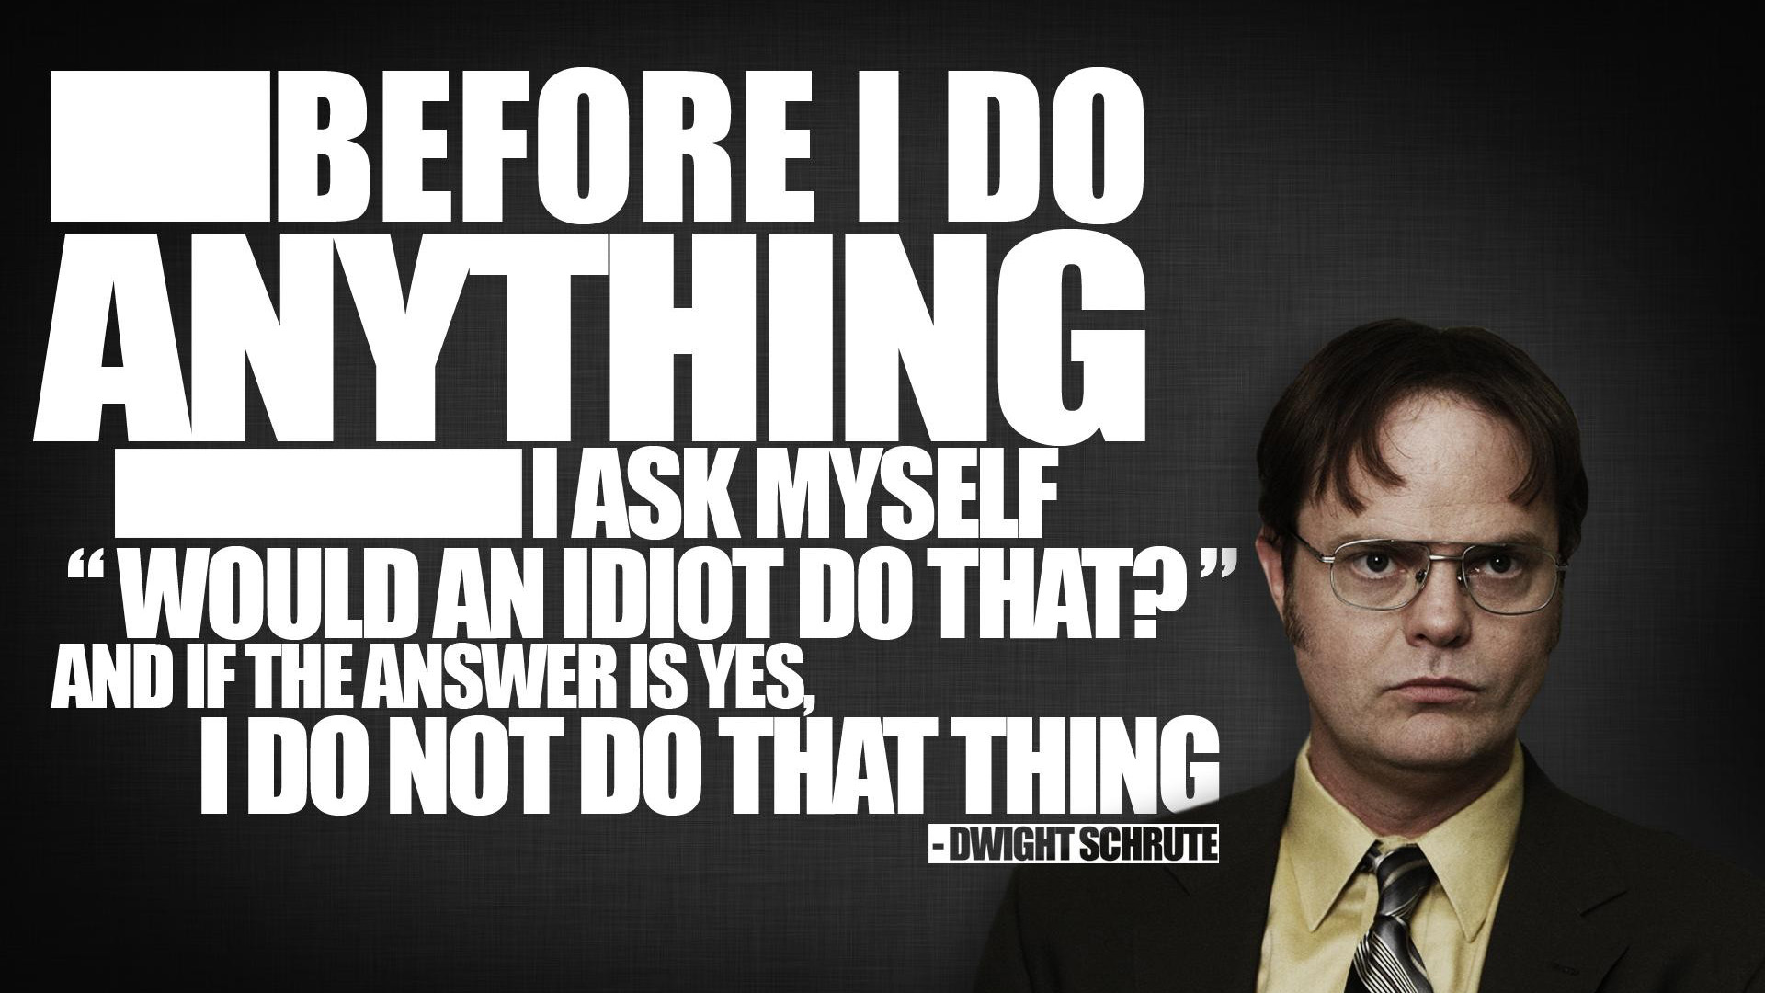

Slide 21
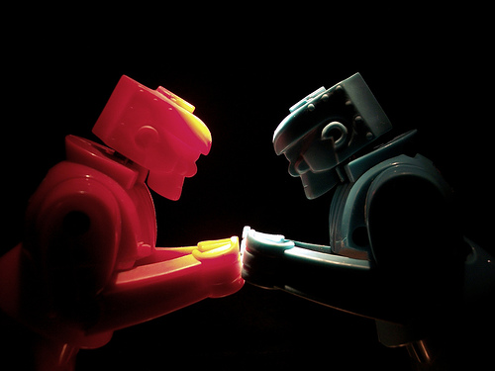
Code_Fight(P1, P2)

Slide 22
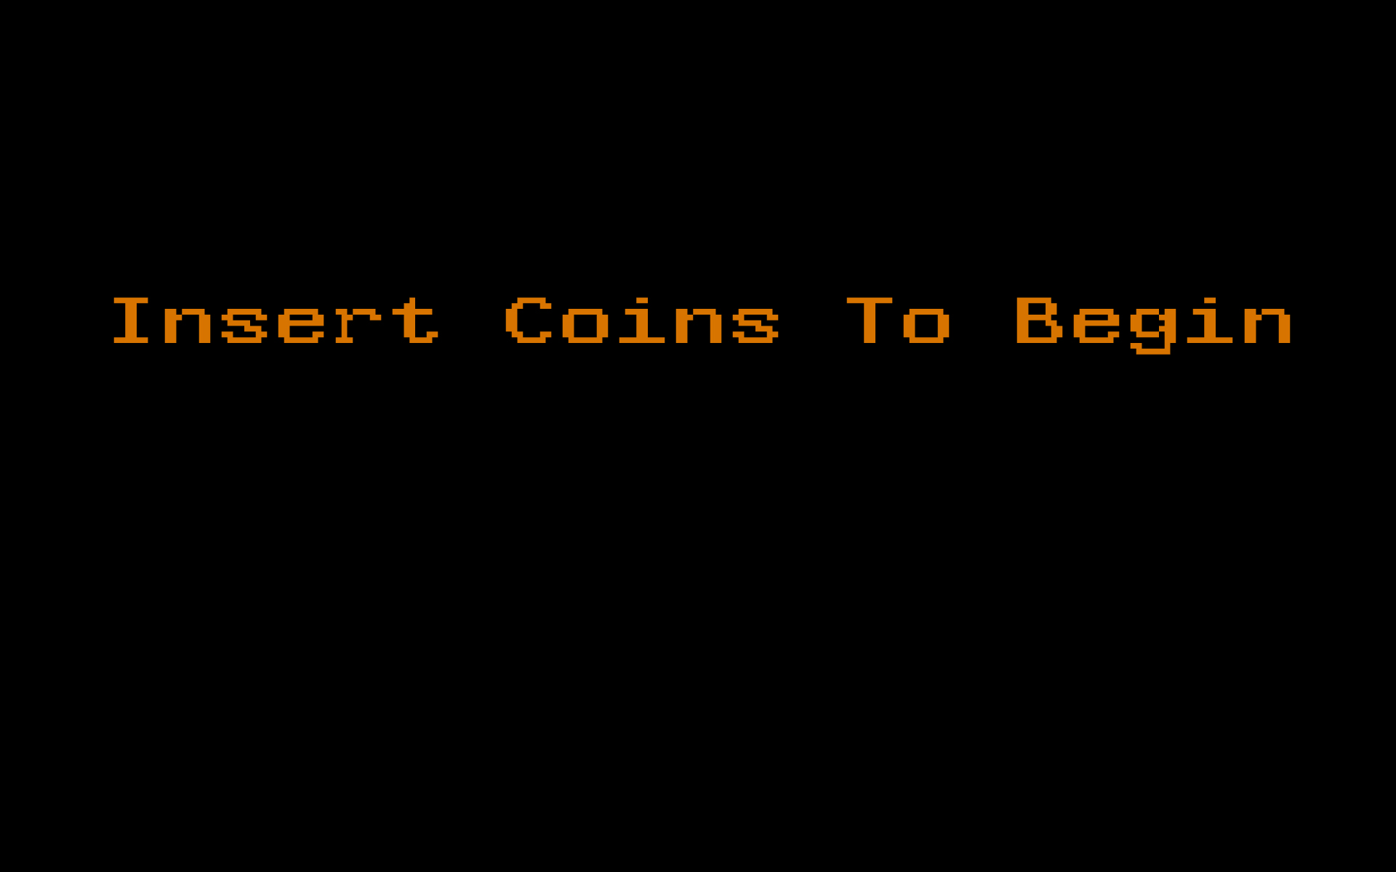

Slide 23
fizzbuzz(integer)
Write a function that takes an integer and returns “fizz” if the number is divisible by 3, “buzz” if it is divisible by 5, “fizzbuzz” if it is divisible by 3 & 5, or returns the number as a string if none of the other conditions are met.
Args:
integer (int): an unsigned integer
Returns:
out (str): string reporting evaluation of int
>>> fizzbuzz(15)
fizzbuzz
>>> fizzbuzz(3)
fizz
>>> fizzbuzz(2)
2

Slide 24
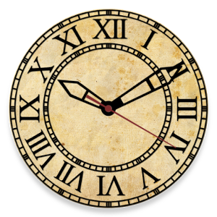
Interview Question
You have an analog watch with a second hand. How many times per day do all three of the watch’s hands overlap exactly?

